Slide 1
Creating Your First Blog using CampusPress
A step-by-step walkthrough

Slide 2
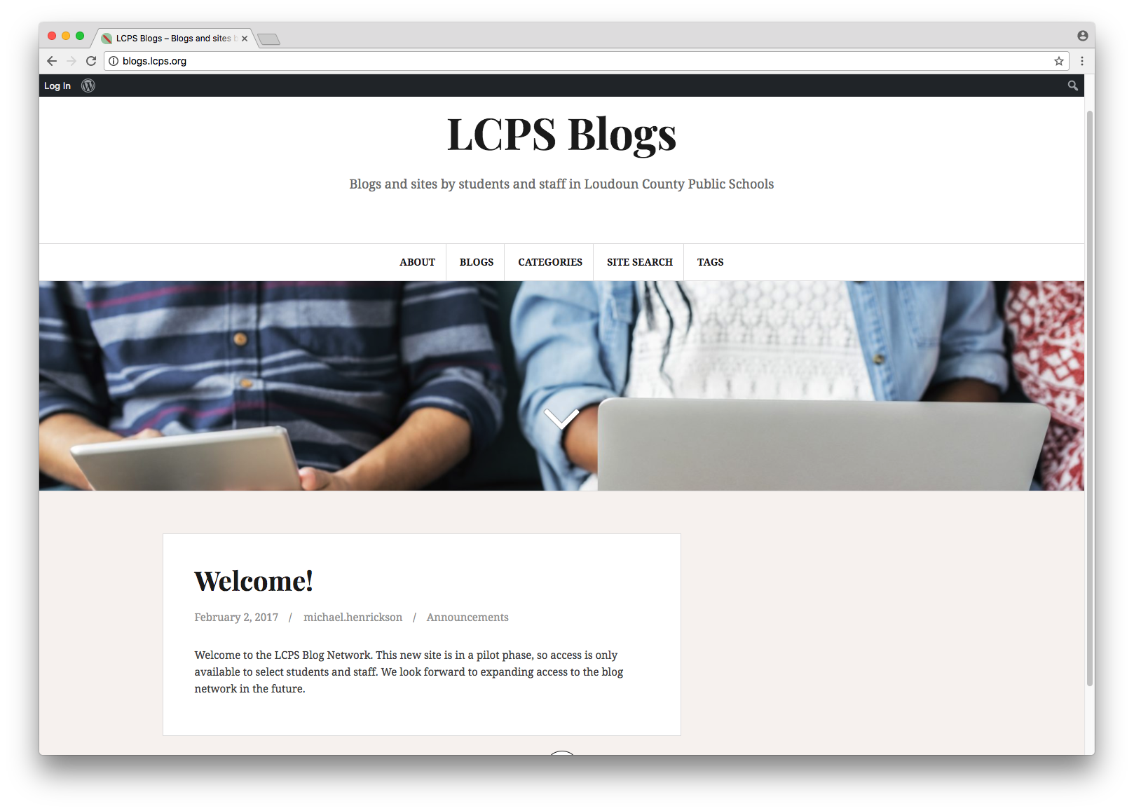
Begin by accessing the LCPS blog site at
blogs.lcps.org
The welcome post indicates you are not yet logged in to CampuPress.

Slide 3
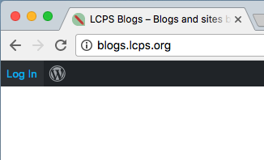
Click the login button at the top left.

Slide 4
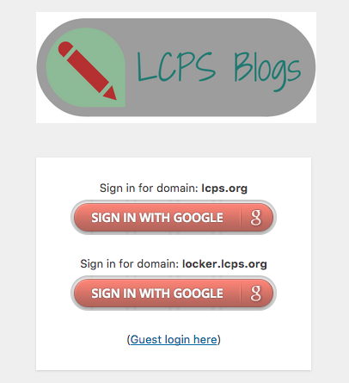
LCPS uses your LCPS Google credentials to authenticate you as a user of CampusPress. Only LCPS staff and students can access the site to create blogs.
If you are a staff member, click on the lcps.org domain login.
If you are a student, click on the locker.lcps.org login.

Slide 5
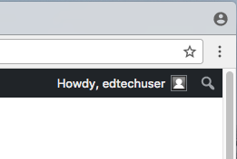
Your username will appear in the top right corner when you are logged in.

Slide 6
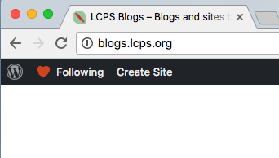
If you do not yet own a blog site, you will see Create Site in the top left corner. Click here to begin.

Slide 7
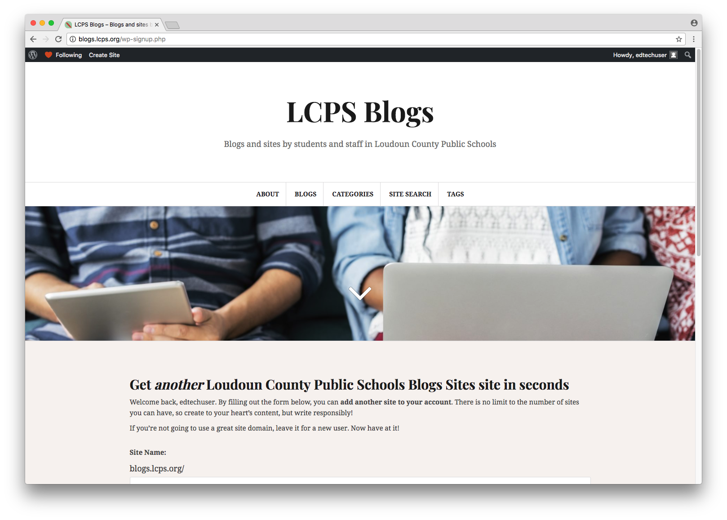
You’ll notice that the welcome post has changed to Get another Loudoun County Public Schools Blogs Sites site in seconds. Scroll down to begin creating your site.

Slide 8
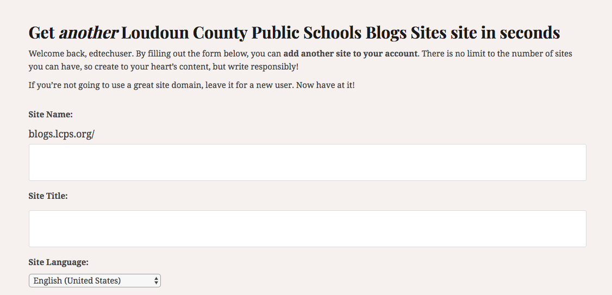
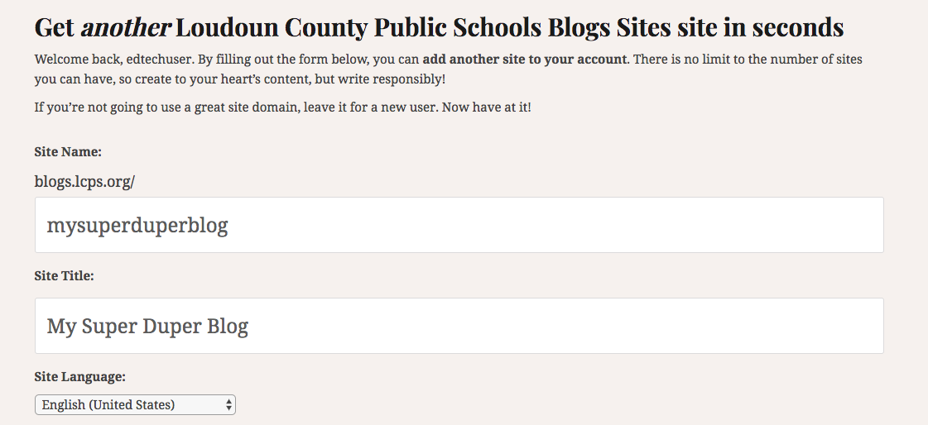
Enter your desired site name and title.
The site name will become your site’s permanent URL so it is important to choose this wisely.
Site names must not contain any spaces or special characters.
The site title will appear on your entry page. It can contain spaces and capitalization.

Slide 9
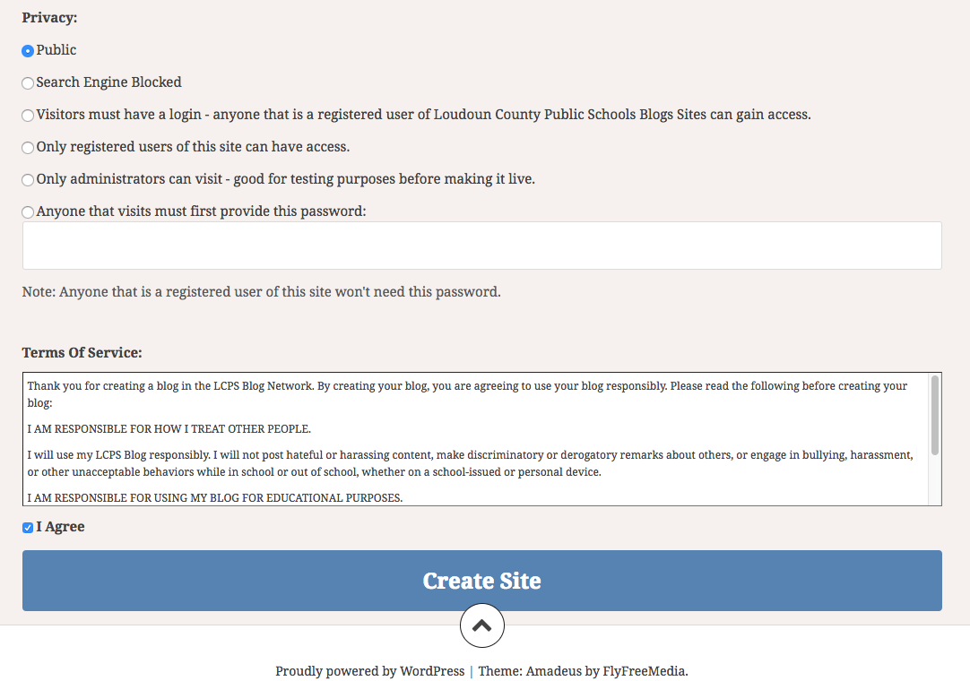
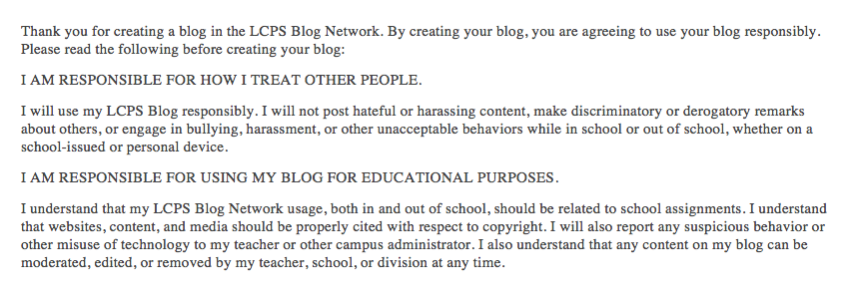
Choose the desired level of privacy for your blog. While you are creating your blog, you may wish to have it only available to you and site administrators. Just be sure to change this when you are ready to go live.
You’ll be asked to read and agree to the terms of service. Read this carefully and understand it. It addresses expectations for how you’ll behave on the site and confirms that the site is to be used for educational purposes only.

Slide 10
Once you have entered your blog name and title and agreed to the terms of service, click Create Site.
A confirmation will appear with your blog name. Click on your blog name to enter your blog and begin customizing it.

Slide 11
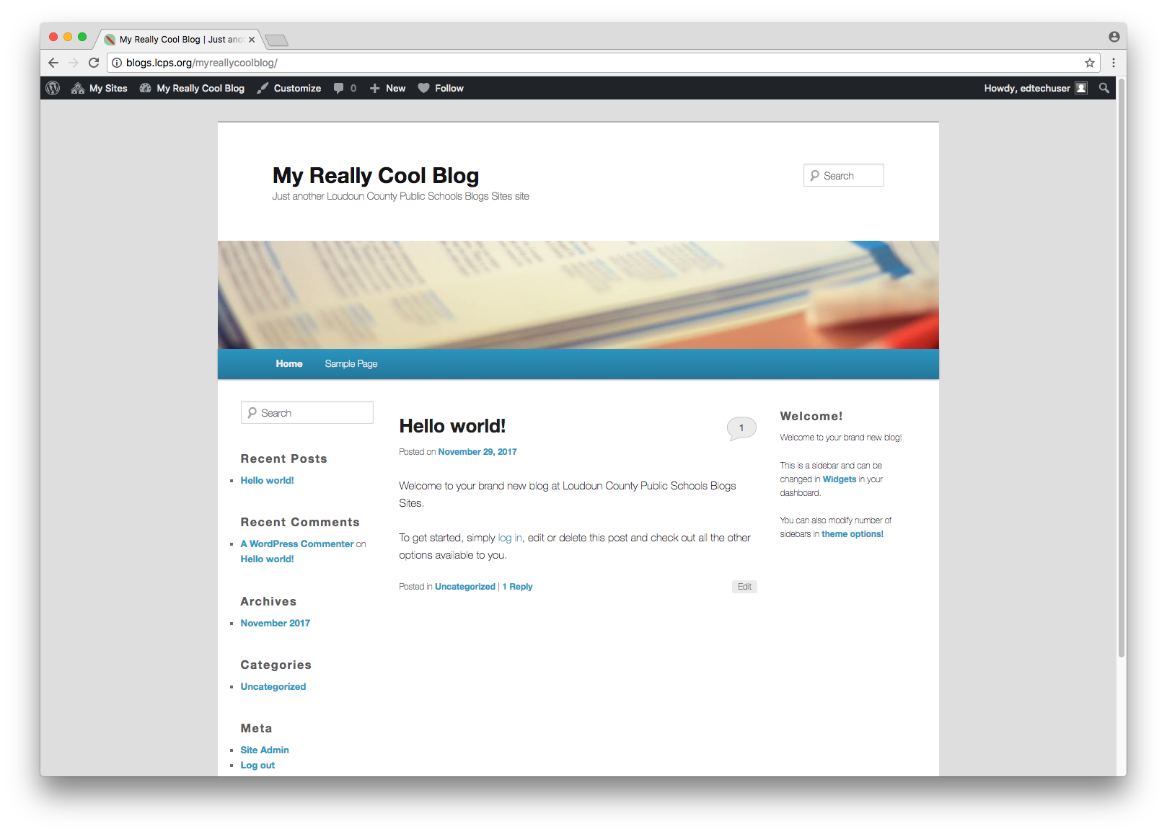
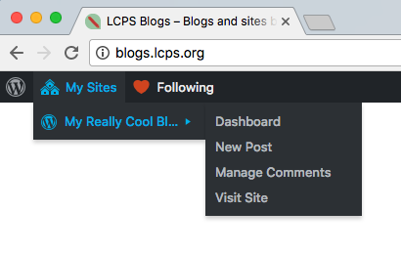
Your newly created blog will appear with a default layout.
You’ll notice a generic Hello post has already been placed on your blog automatically.
To access your site in the future once you login, click on My Sites in the top left corner.

Slide 12
The main functions of managing your blog are found within the drop-down menu of My Sites.
Begin by clicking on Dashboard, which reveals a menu of tools on the left.
You can begin by editing the generic Hello post, by choosing Posts and selecting this post.

Slide 13
Replace the title and content of the generic Hello post.
Notice that the post’s permalink URL says “hello-world” and will also need to be edited to match your new entry by clicking the edit button next to the link.

Slide 14
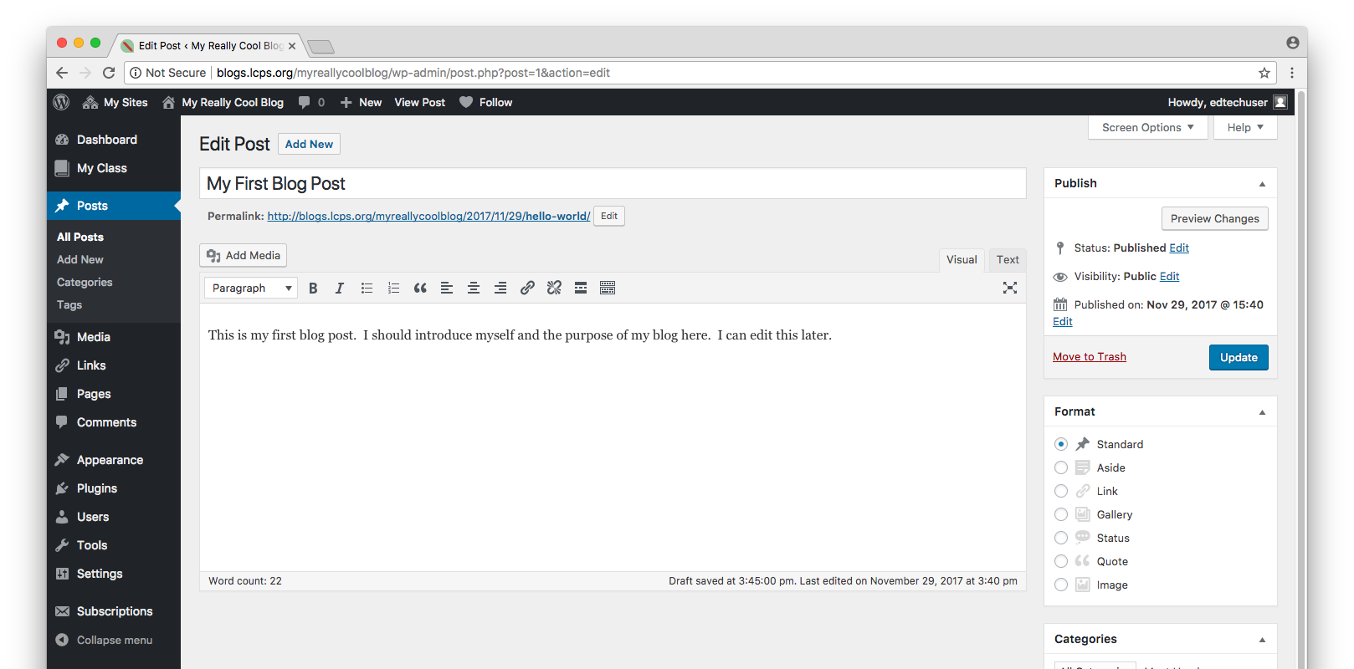
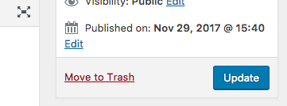
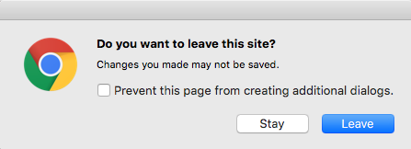
You can preview your new post by clicking the Preview Changes button on the right.
In order for your new post to take effect, you must click Update on the right.
If you accidentally try to navigate away from a page before clicking Update or Publish, this message will appear to confirm your intent to navigate away without saving the changes. Be sure to click Stay and click Update or Publish before navigating away.

Slide 15
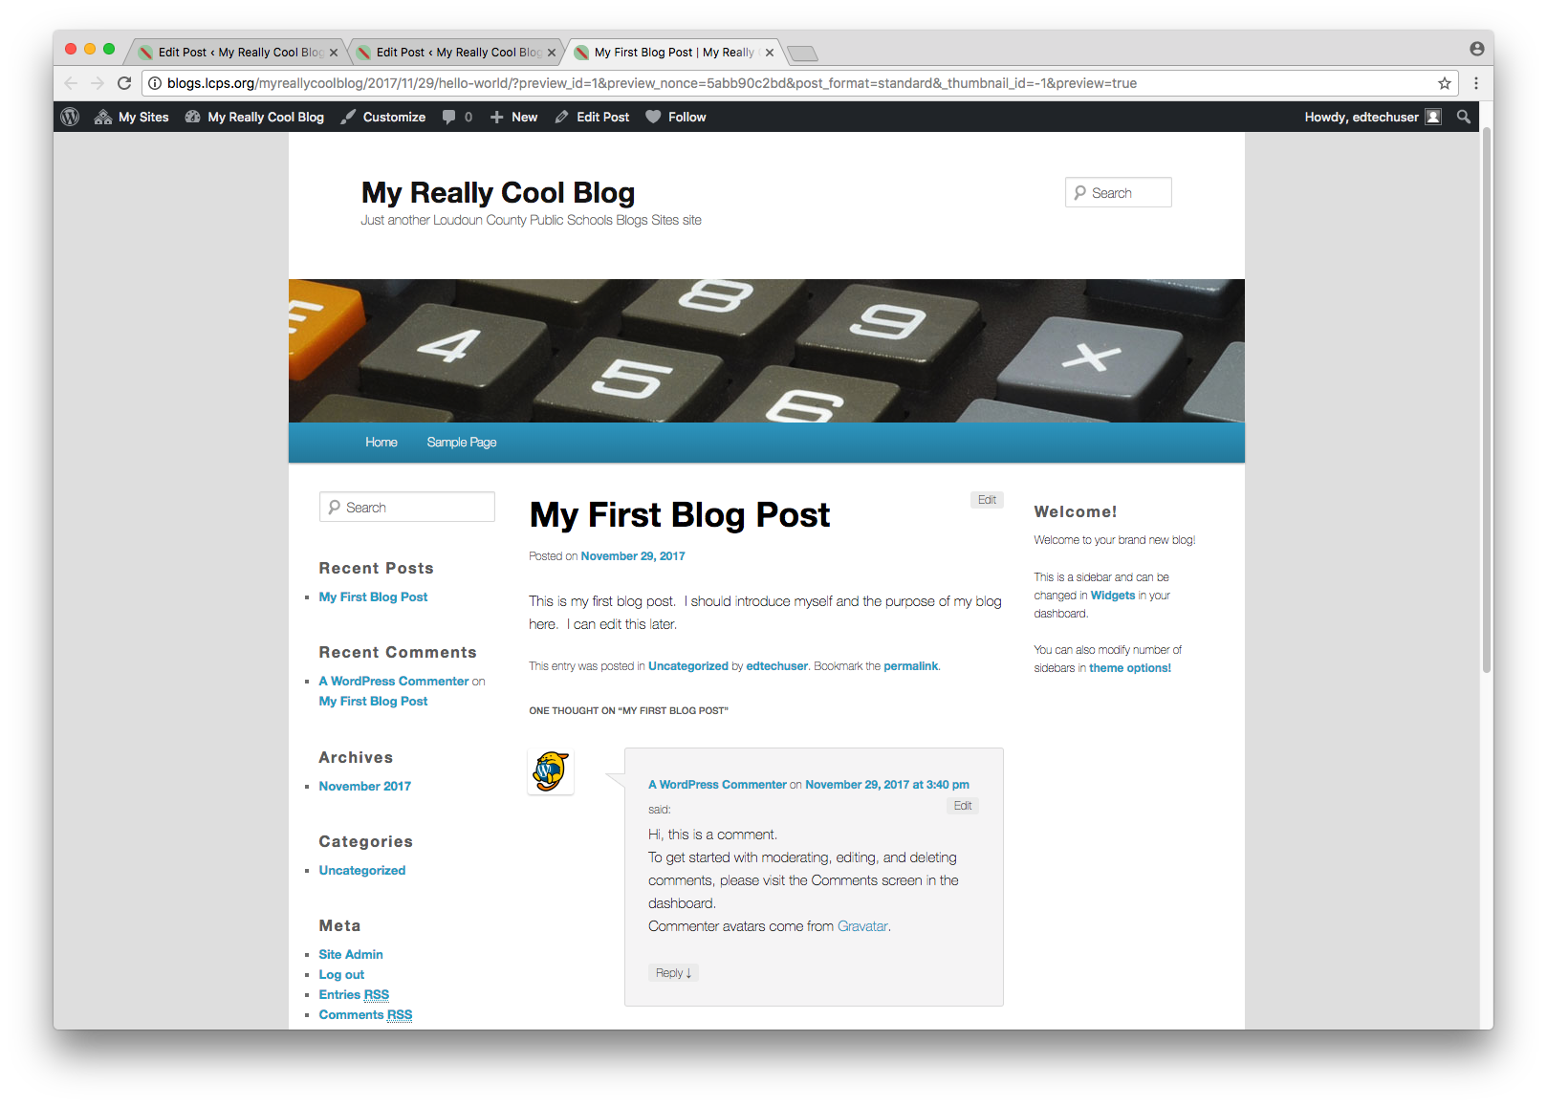
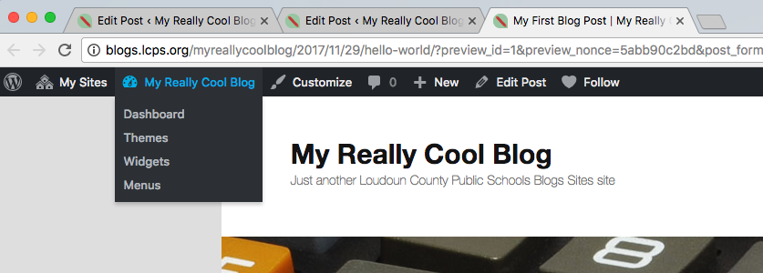
Preview your blog with your revised initial post. You’ll notice there is also an auto-generated reply. We’ll address that later.
Return to the dashboard to begin customizing your blog.

Slide 16
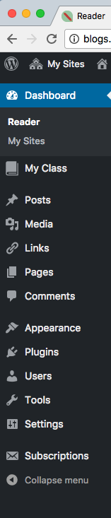
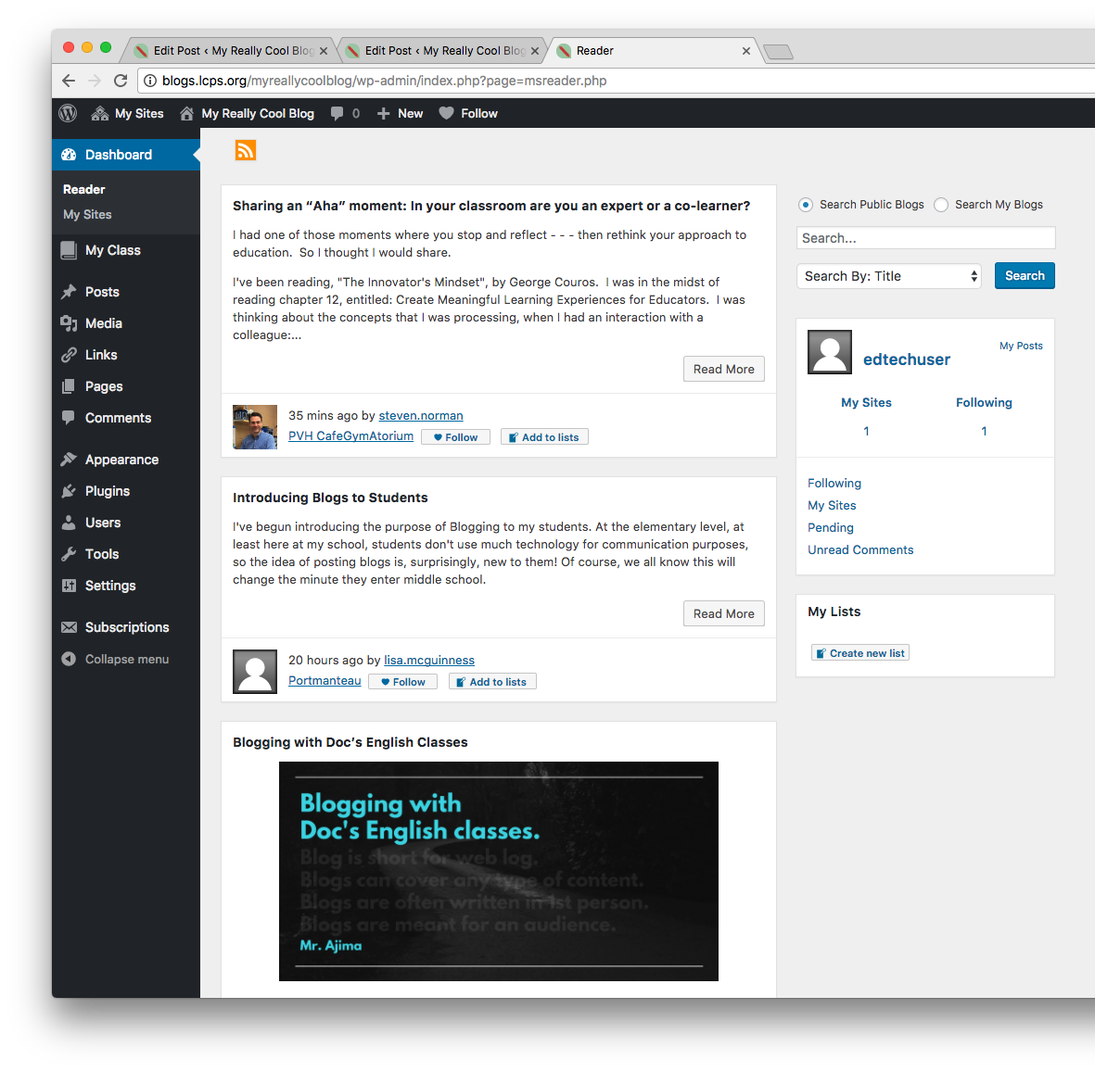
When you view the dashboard, you’ll see recent posts on other blogs within the LCPS blog community, some stats regarding your use of CampusPress, and a search tool.

Slide 17
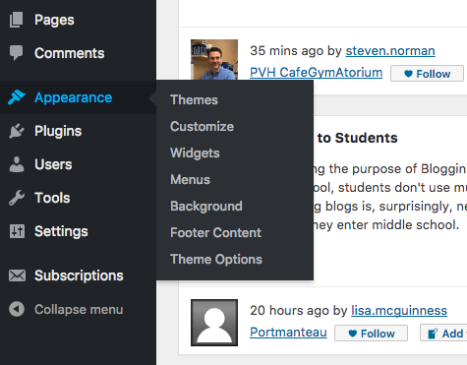
You’ll customize your blog by using several items within the Appearance menu.
Begin by choosing Themes to select a design layout that matches the look and feel you want to create for your blog.

Slide 18
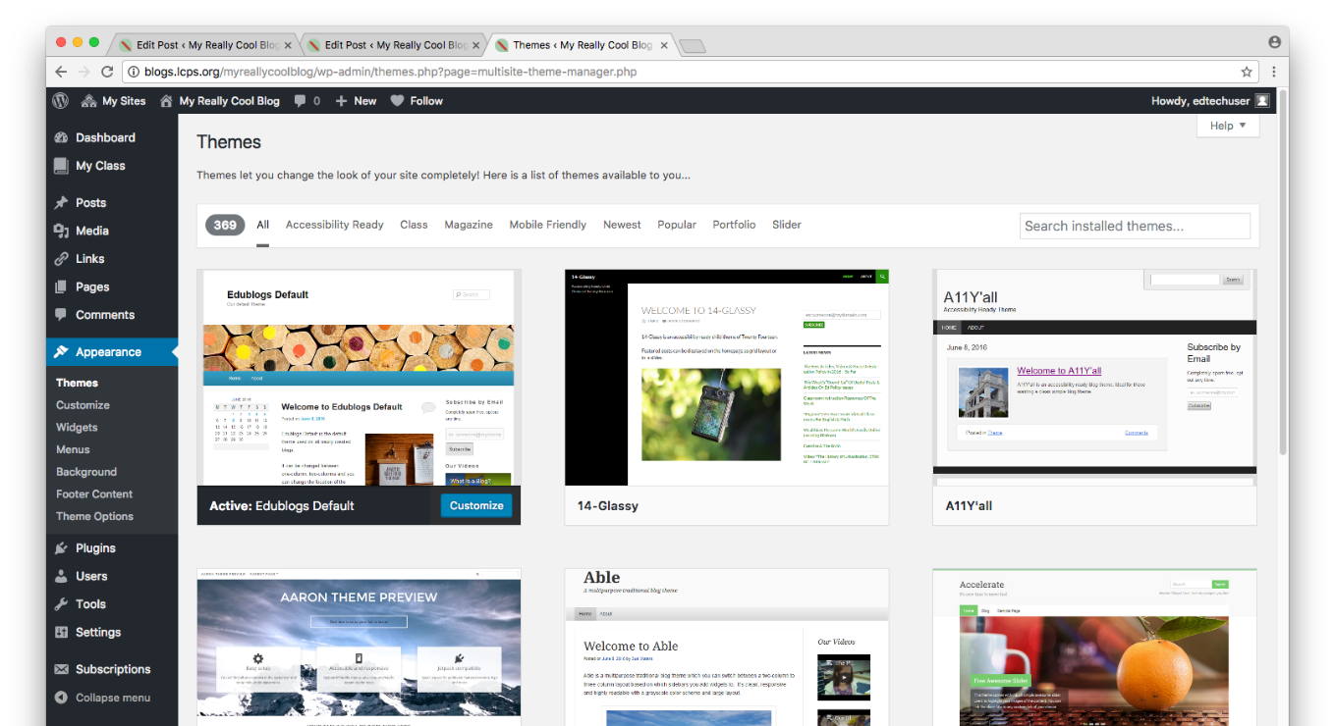
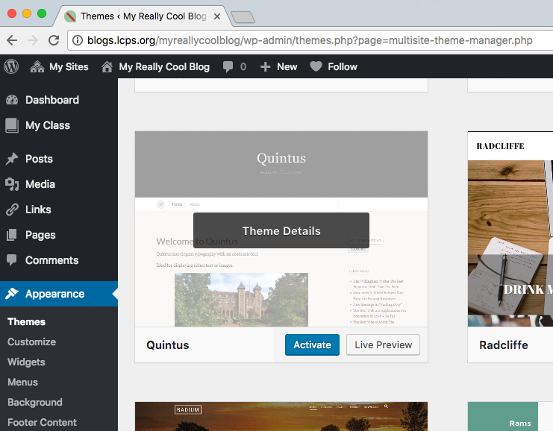
You can browse themes by using the navigation menus at the top, searching, or scrolling down to view all available themes.
When you hover over a theme’s thumbnail image, you can access Theme details, or click to see a live preview or activate the theme.

Slide 19
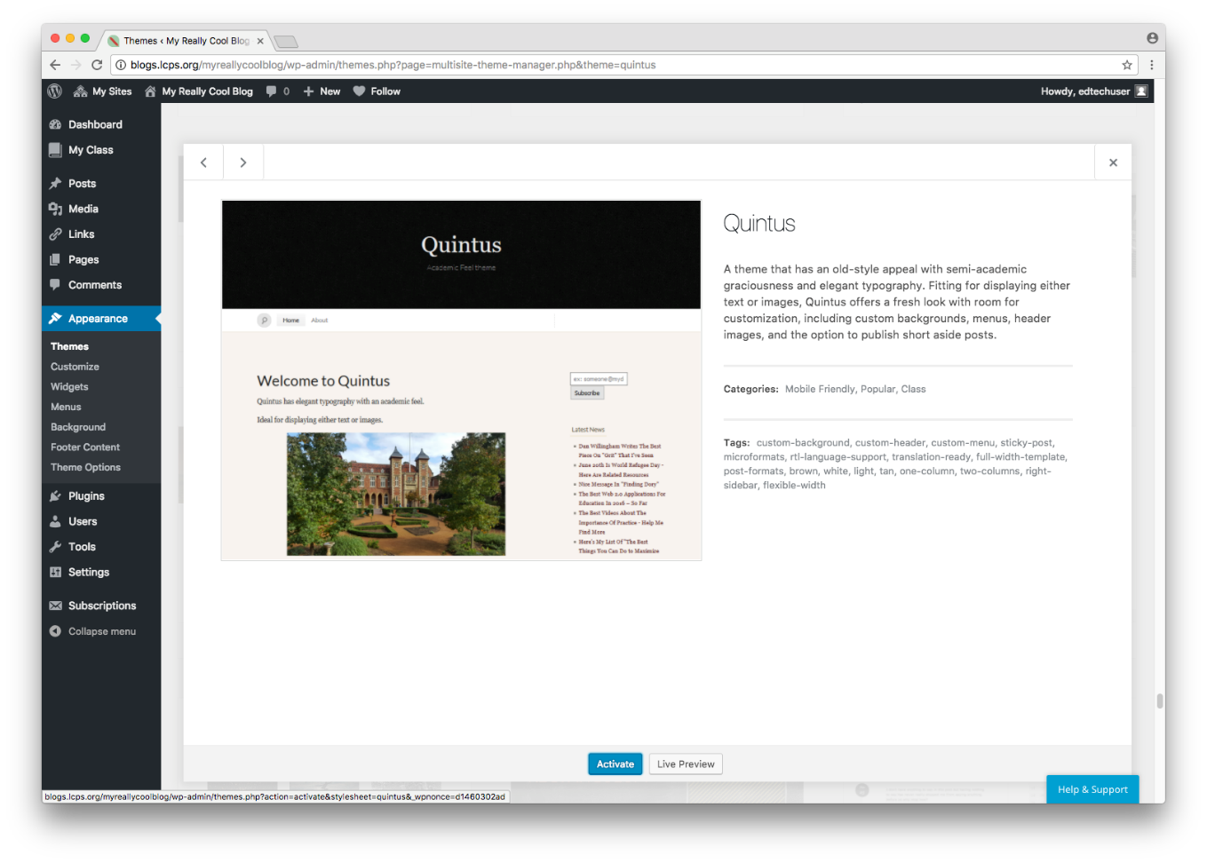
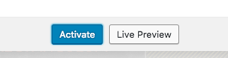
The theme preview pane provides a visual preview as well as information about whether it is mobile friendly, how many columns it supports, and which items can be customized.
Use the Live Preview button to see what the them looks like when applied to your content as well as to access and make additional choices to customize your blog.

Slide 20
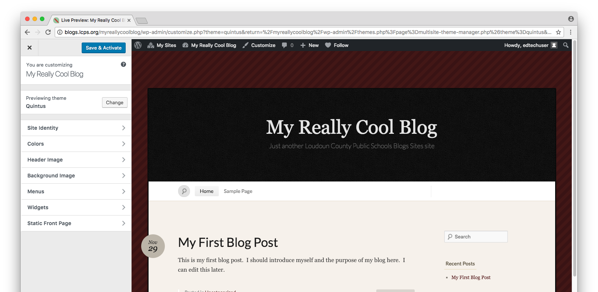
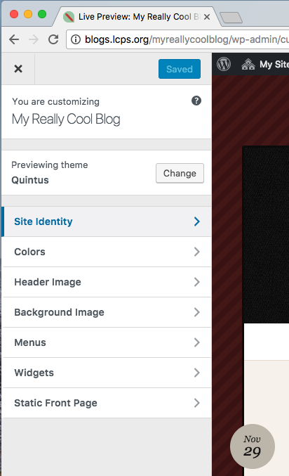
While previewing a theme, use the menu options within the controls to the left to apply additional customization.
You can also access the Customization controls later within the Appearance menu on your Dashboard.

Slide 21
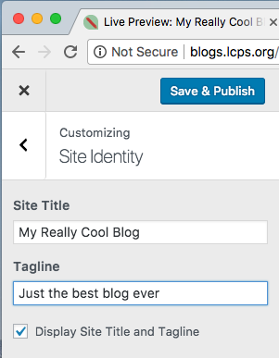
Begin with Site Identity where you can adjust your blog title if you’d like and edit the tagline. By default all blogs will say Just Another Loudoun County Public Schools Blogs Sites site. You can remove or edit this tag line.

Slide 22
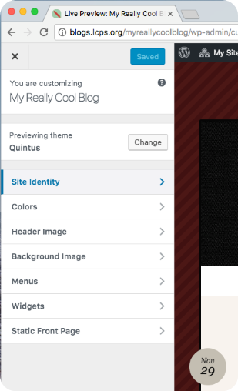
You can customize Colors and apply a Header Image, and/or Background Image within the Customization controls if desired.
Menus and Widgets are advanced topics you may wish to explore later.

Slide 23
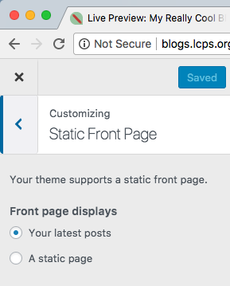
Select the Customization item Static Front Page to define whether your front page should display a static page (such as an introduction to the blog or an about page) or display your latest posts.
If you choose A static page you will be able to choose the page you wish to use.

Slide 24
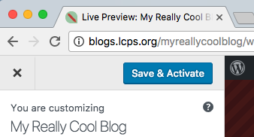
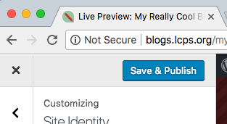
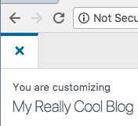
When you are done customizing the appearance of your blog, be sure to click Save and Activate if you are in preview mode or Save and Publish if you are in edit mode.
Click the X to exit out of the customization pane.

Slide 25
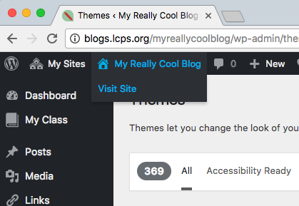
Use the menu to visit your site and see how your customized appearance settings look.

Slide 26
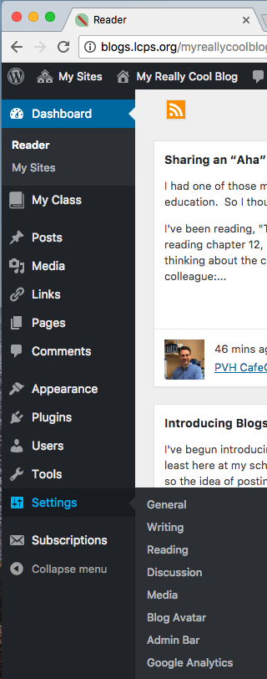
Click on Settings to define some important features of your blog.

Slide 27
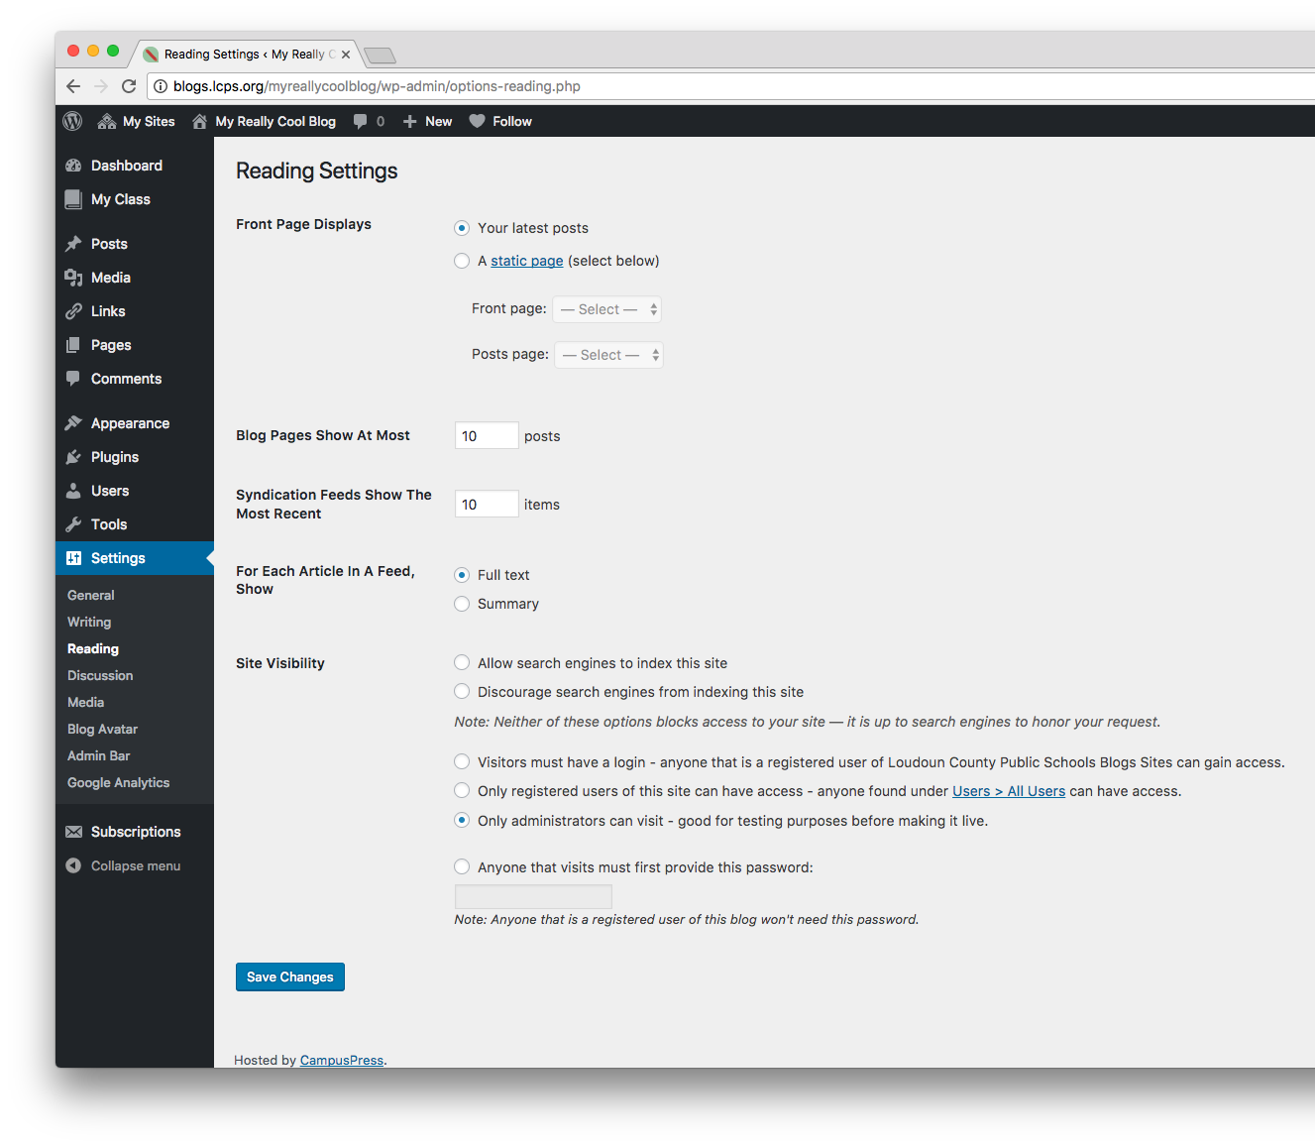
Within Settings, click on Reading to define your front page, how many posts appear at once, and who has access to view posts on your blog.
Be sure to Save Changes at the bottom before exiting the reading settings.

Slide 28
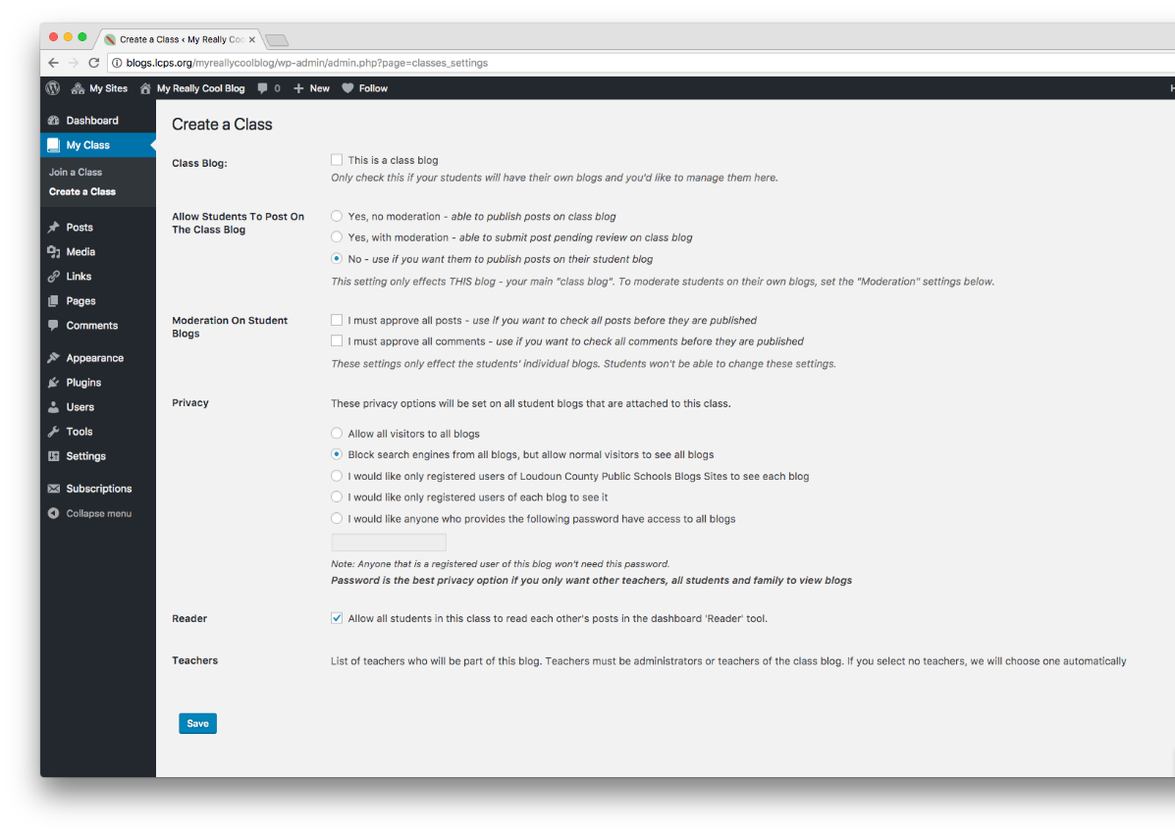
As a teacher, you can utilize the My Class tool to attach student blogs to your class blog and then control student blog privacy, comment moderation, and post moderation on all student blogs with one click.
This help article provides details about using the My Class feature: http://help.edublogs.org/set-up-my-class/

Slide 29
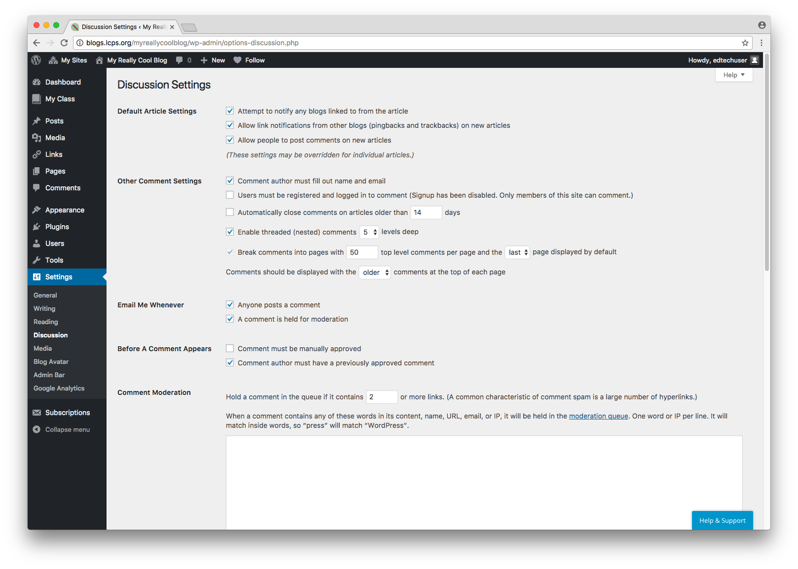
Click on Discussion to define important settings regarding comments, notifications of new comments, and approving of comments before they are visible to others.
Signup has been disabled within the LCPS blog site, so only logged-in LCPS staff and students can comment.
You can also define keywords to automatically hold comments until moderated. The entire LCPS blog site has common objectionable keywords already defined so it is not necessary to add these here.

Slide 30
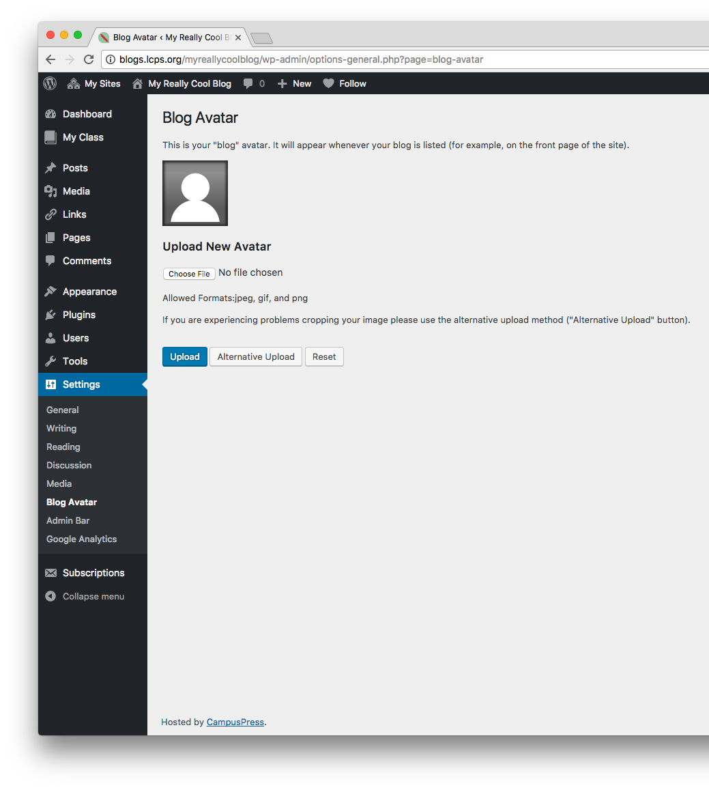
Click on Blog Avatar to upload a unique avatar symbol to represent you within the blog site.

Slide 31
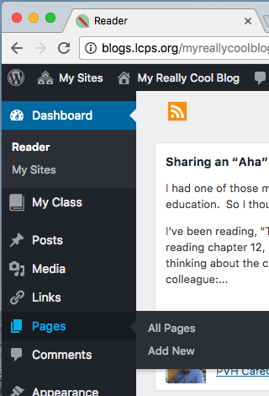
Use the Pages menu within the dashboard to manage existing pages or create new pages.
Pages differ from Posts in several ways. Access this help article to learn more:
https://tinyurl.com/blogpagesandposts

Slide 32
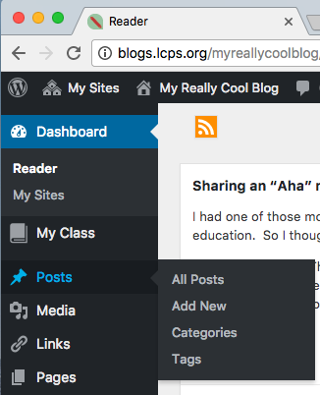
Use the Posts menu within the dashboard to add a new post or manage existing posts, categories, or tags.

Slide 33
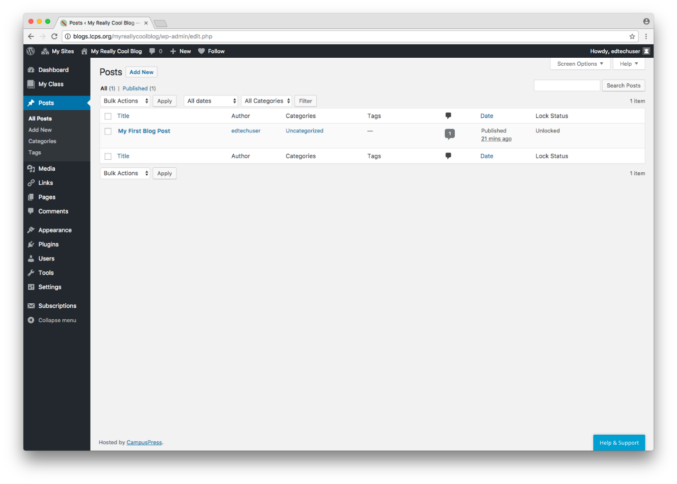
Hover over or click on a specific post to edit or manage it.
Select multiple posts using the check boxes to apply bulk actions to multiple posts. Apply has to be selected to apply bulk changes.

Slide 34
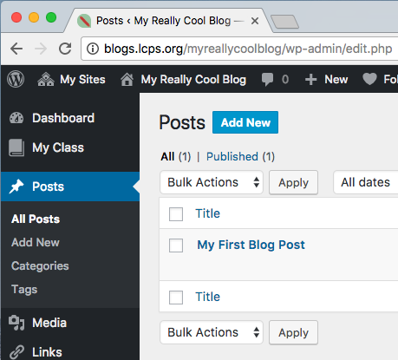
To create a new post, hover on Posts and then select Add New or if you are already in the Posts pane, click Add New.

Slide 35
Type the title of your post.
Type the content of your post.
Utilize the menu above the content pane to format the text and add images and links.

Slide 36
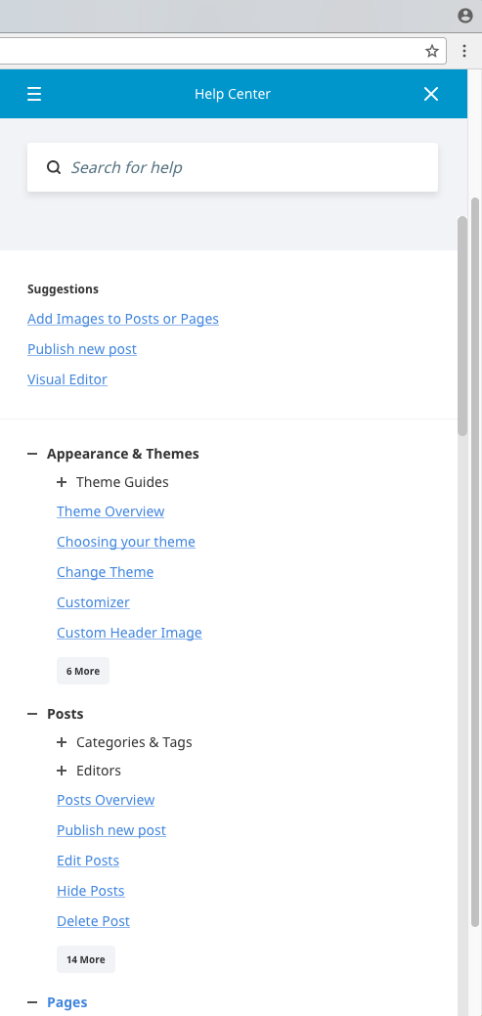
Define categories and tags associated with your post using the pane to the right. Categories and tags help you and others find your post and related posts later.
You’ll also notice the Help & Support menu available at the bottom of this pane. CampusPress’s help is context based and will provide help articles most likely related to what you are currently doing.

Slide 37
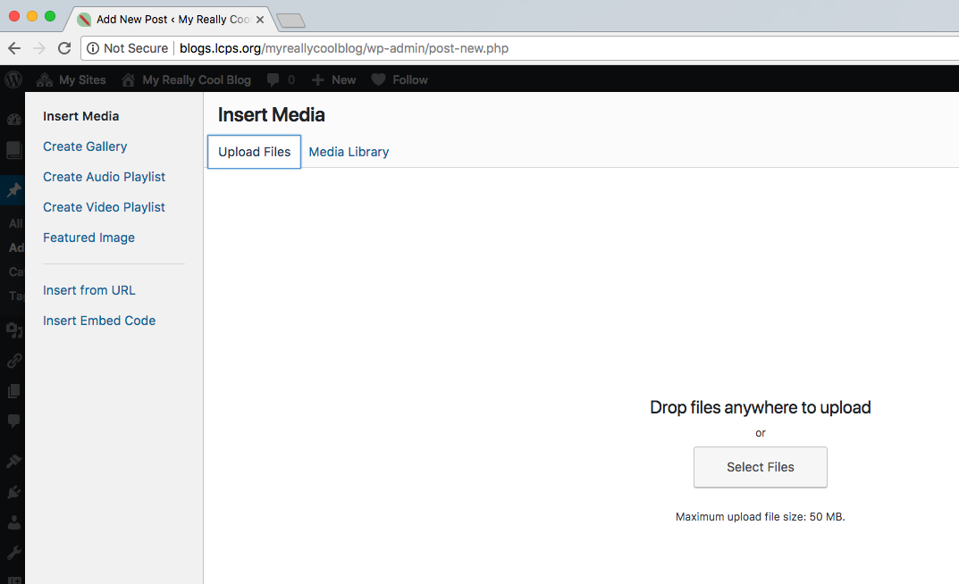
Use the Add Media button to add an image or other media to your post.
You can upload files from your computer or navigate to the media library to select media already uploaded to your site.

Slide 38
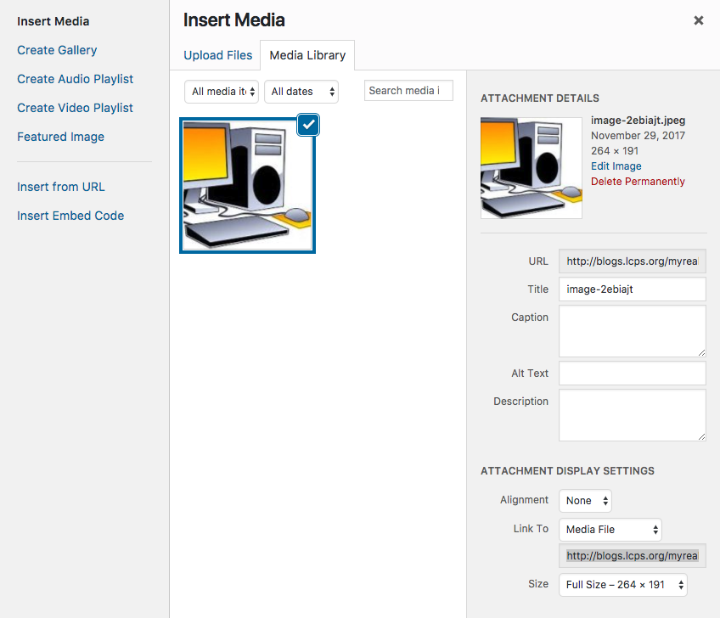
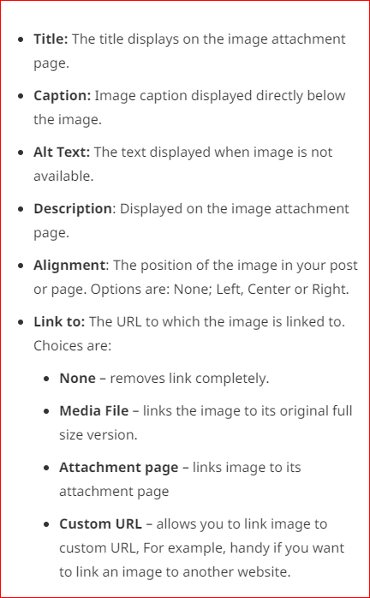
When uploading a new image to your site, it is important to include Alt Text at a minimum. This is the text that will display if an image doesn’t load for any reason and is also what a screen reader will read aloud for a user with a visual impairment. As a public institution, the law states A text equivalent for every non-text element shall be provided.
You can also use the Caption or Description fields to cite your image if necessary. If you use the description field for this purpose, next to Link To, choose Attachment Page so that when a user clicks on the image, it displays the description/citation information.
http://warc.calpoly.edu/accessibility/508indepth/alternate.html

Slide 39
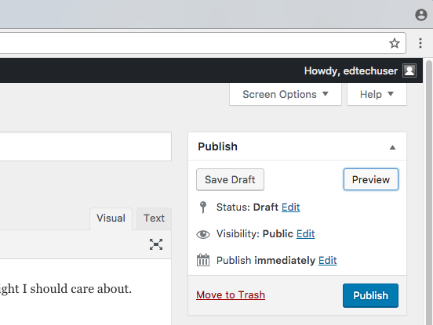
Preview your post before publishing using the Preview button and select Publish when you are ready to publish your post to your blog.
If you accidentally try to navigate away from a post before clicking Publish or Update, this message will appear to confirm your intent to navigate away without saving the changes. Be sure to click Stay and click Publish or Update before navigating away.

Slide 40
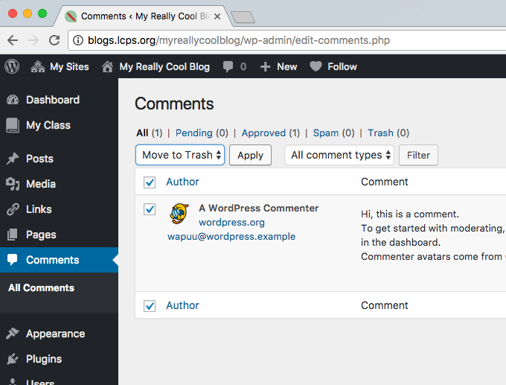
Remember that generic, auto-created Post reply on your first post? Let’s address that now.
Select Comments in the Dashboard to manage comments just as you’ve managed pages and posts.
Here you can delete or edit the auto-created reply.

Slide 41
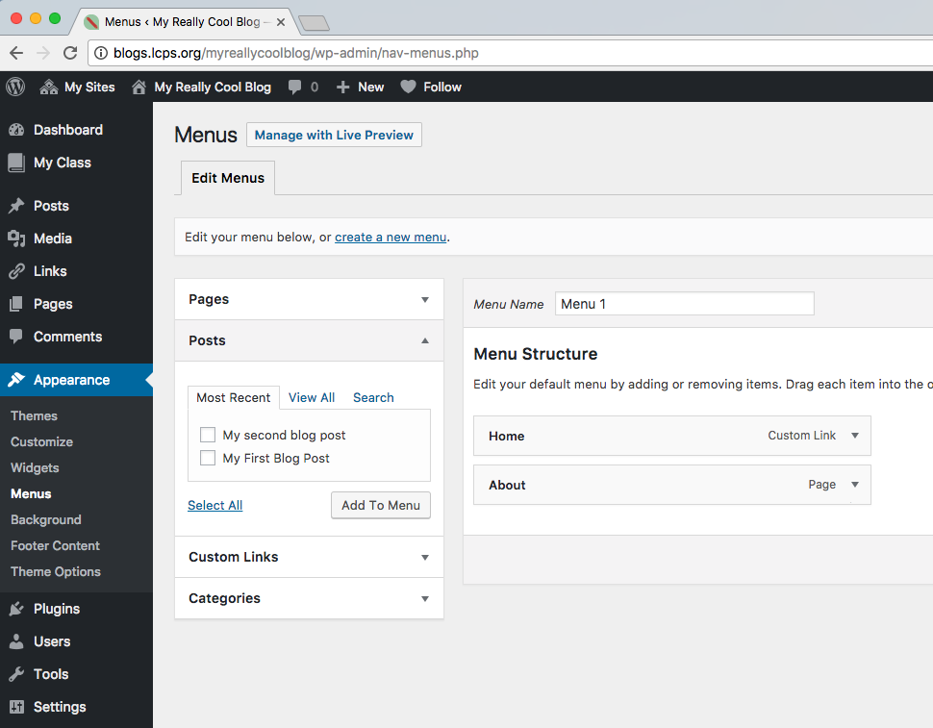
You can define and control Menus within the Appearance menu on your Dashboard.
You can establish pages, posts, links, or categories as menu items, arrange the order of menu items, and define submenus.
If your design template allows, you can also create additional menus altogether.

